Slide 1


HTTP Request Methods

Slide 2
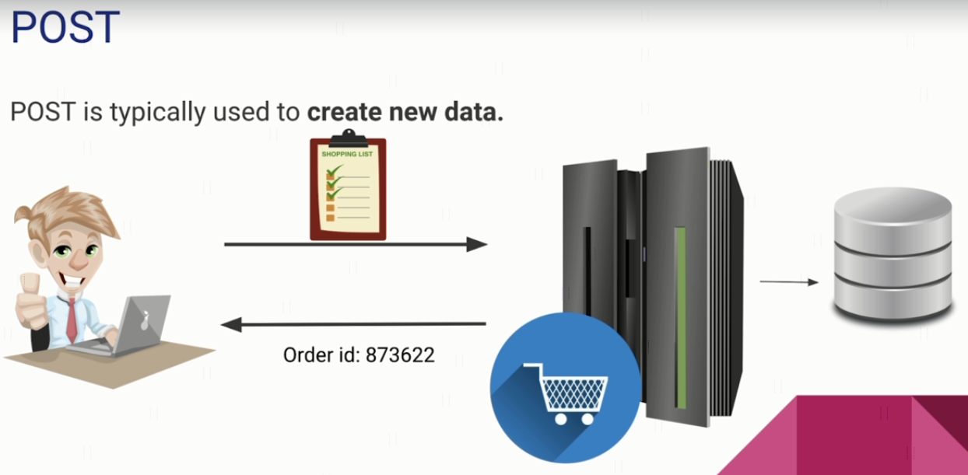
HTTP Request Methods

Slide 3
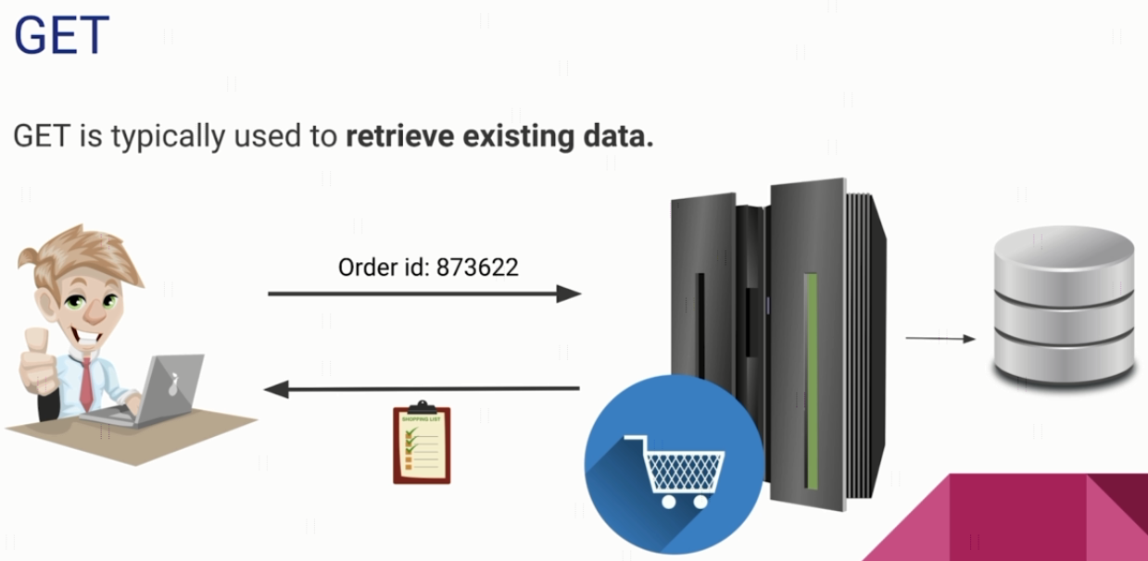
HTTP Request Methods

Slide 4
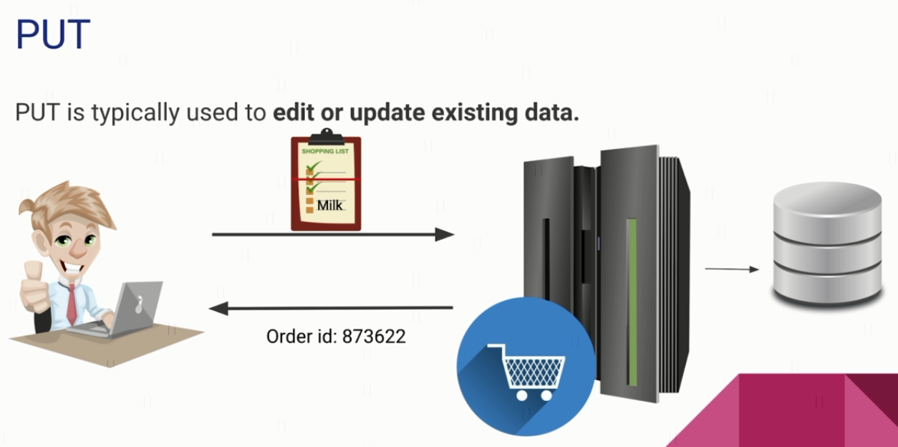

HTTP Request Methods

Slide 5
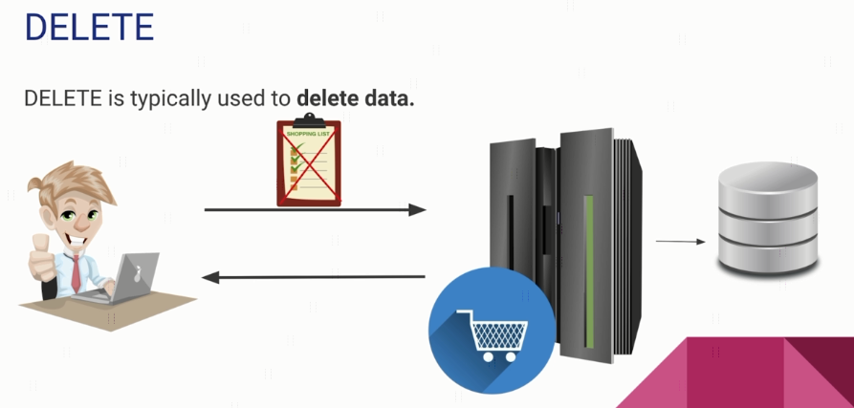
HTTP Request Methods

